Slide 1

Team31,
Department of Electronics and Communication Engineering,
KIET Group of Institutions
10th August, 2023

Slide 2
Mission Statement
Vision Statement
Our mission is to pioneer the field of humanoid robotics with a strong emphasis on innovation, cultural representation, and technological excellence. We aim to create a humanoid robot that not only showcases India's capabilities on an international stage but also pushes the boundaries of what is possible in the realm of robotics. Through our project, we aspire to inspire the next generation of engineers and creators to explore the exciting world of robotics and artificial intelligence.
Our vision is to establish our humanoid robot, Anushka, as a symbol of India's technological prowess and creative brilliance. We envision Anushka as a versatile and intelligent robot that is capable of contributing to various sectors, from healthcare and education to entertainment and hospitality. By combining cutting-edge technology with cultural and scientific wisdom, our vision is to redefine the possibilities of humanoid robotics and set new benchmarks for innovation.

Slide 3
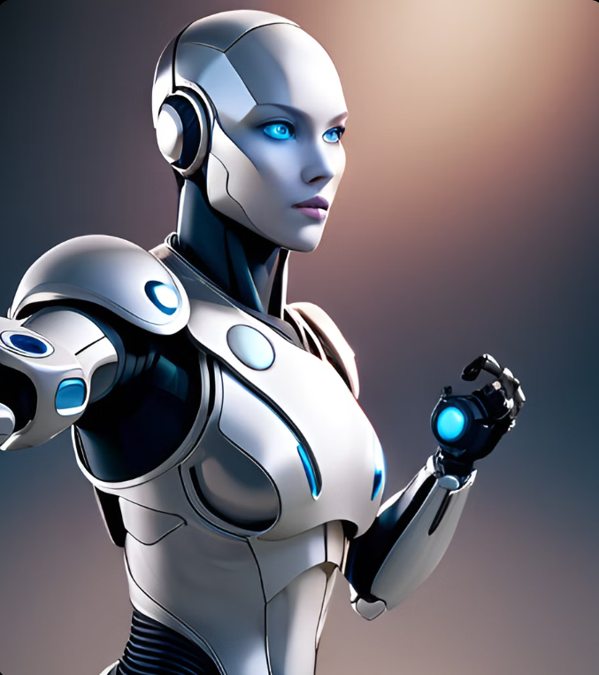
What are Humanoid Robots?
Humanoid robots are machines designed to resemble and function like humans. They typically have a head, torso, arms, and legs, and are programmed to perform tasks that mimic human behavior.
Unlike other types of robots, humanoid robots have the ability to interact with humans in a more natural way. This makes them well-suited for a variety of applications, such as healthcare, education, and entertainment. For example, they can be used in hospitals to assist with patient care, or in schools to provide language learning or tutoring services.

Slide 4
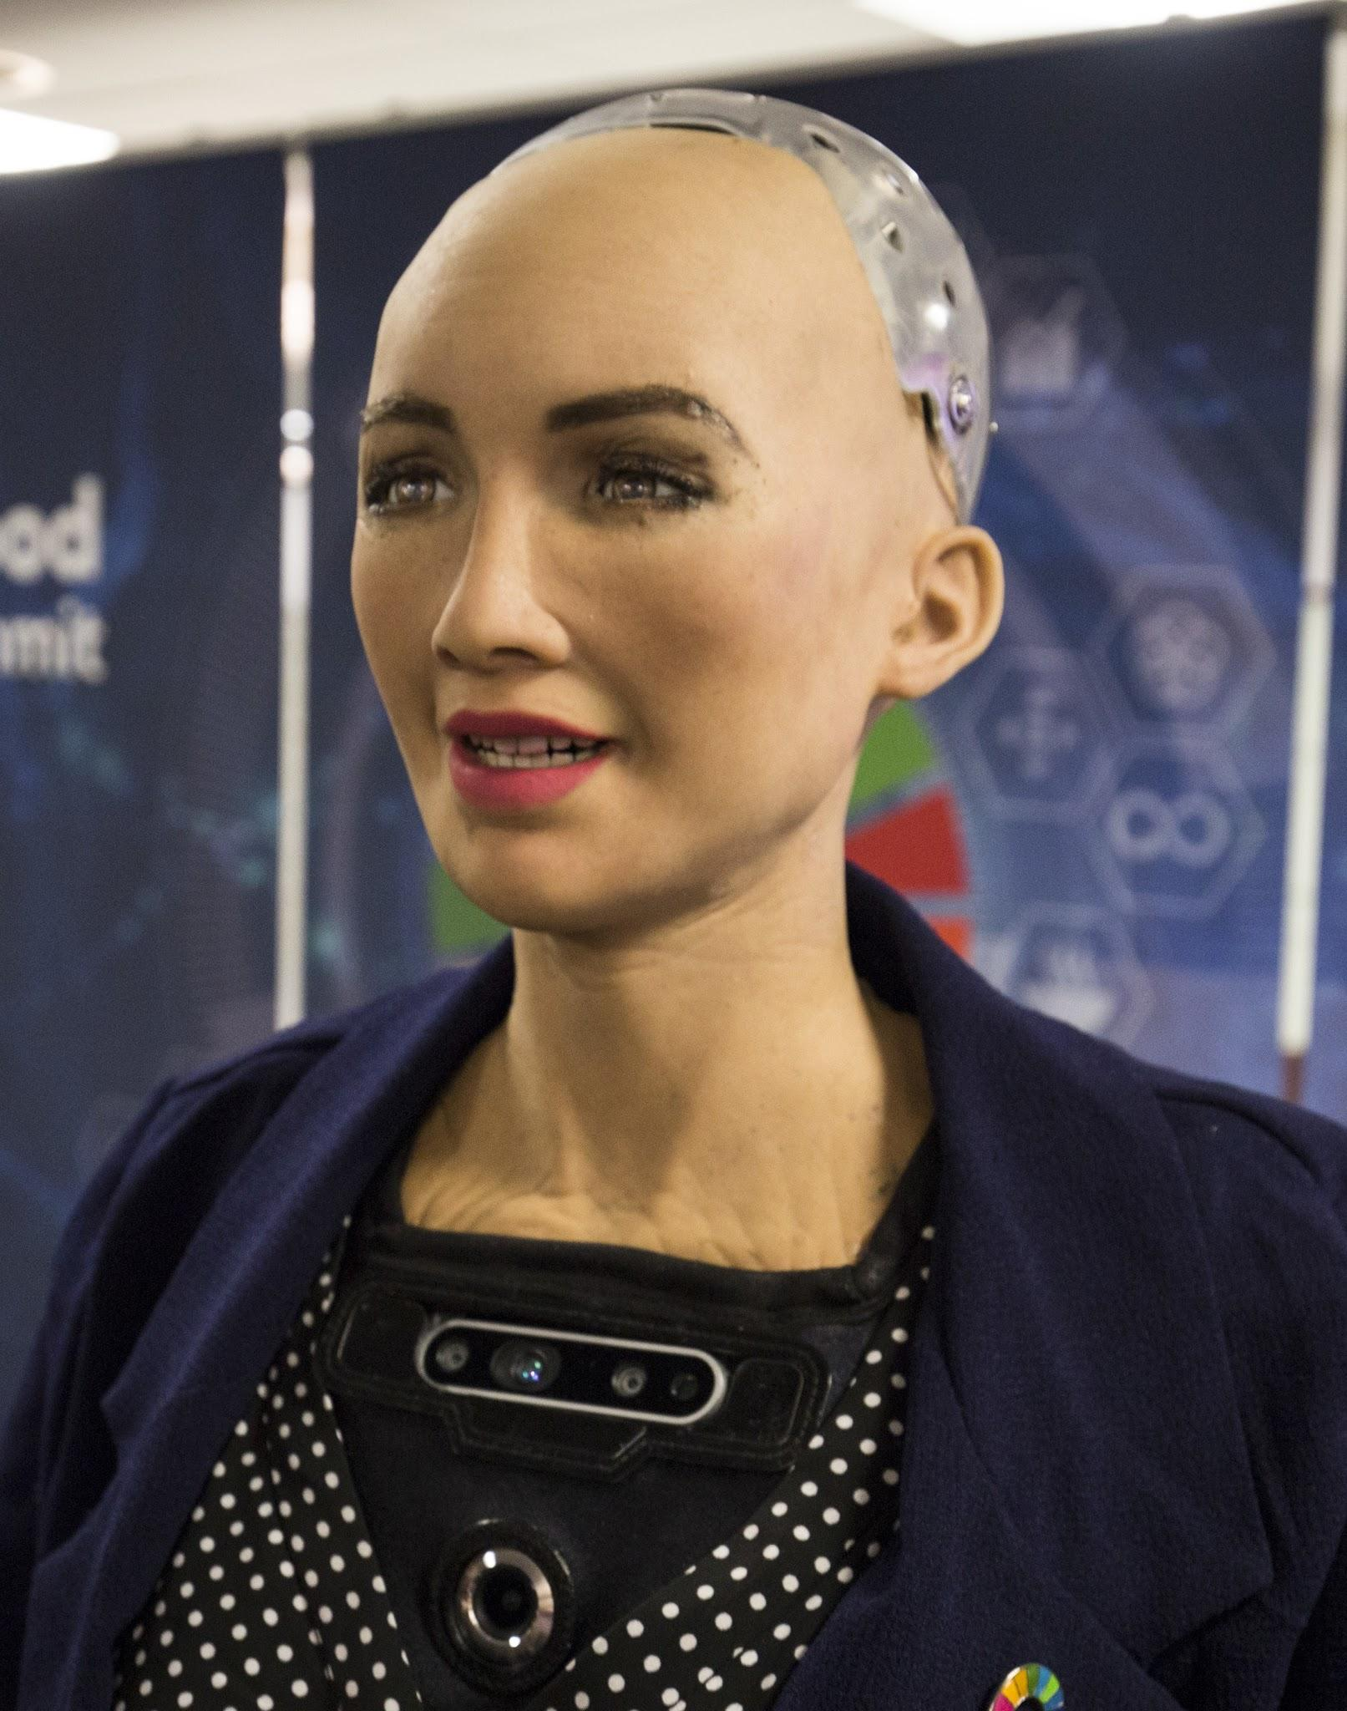
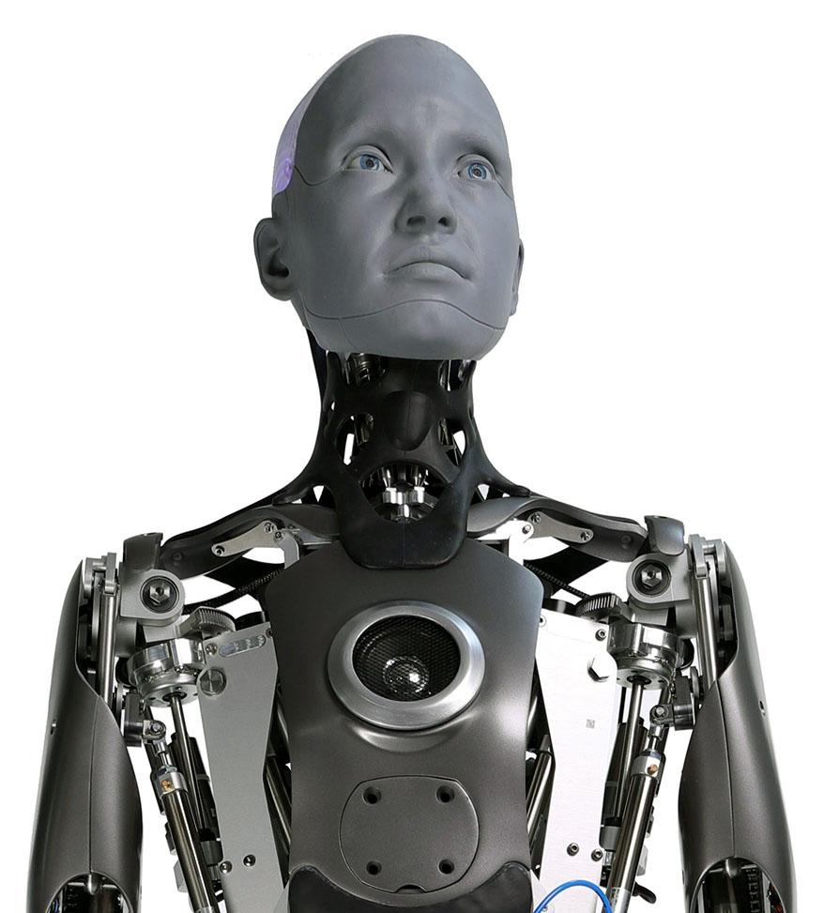
Humanoids at International level
There are various Humanoid Robots made across the world, out of which only two stand at a level of high artificial advancement of intelligence and relative movements of humanoid parts.
They are:
Sophia by Hanson Robotics
Ameca by Mexican Government

Slide 5
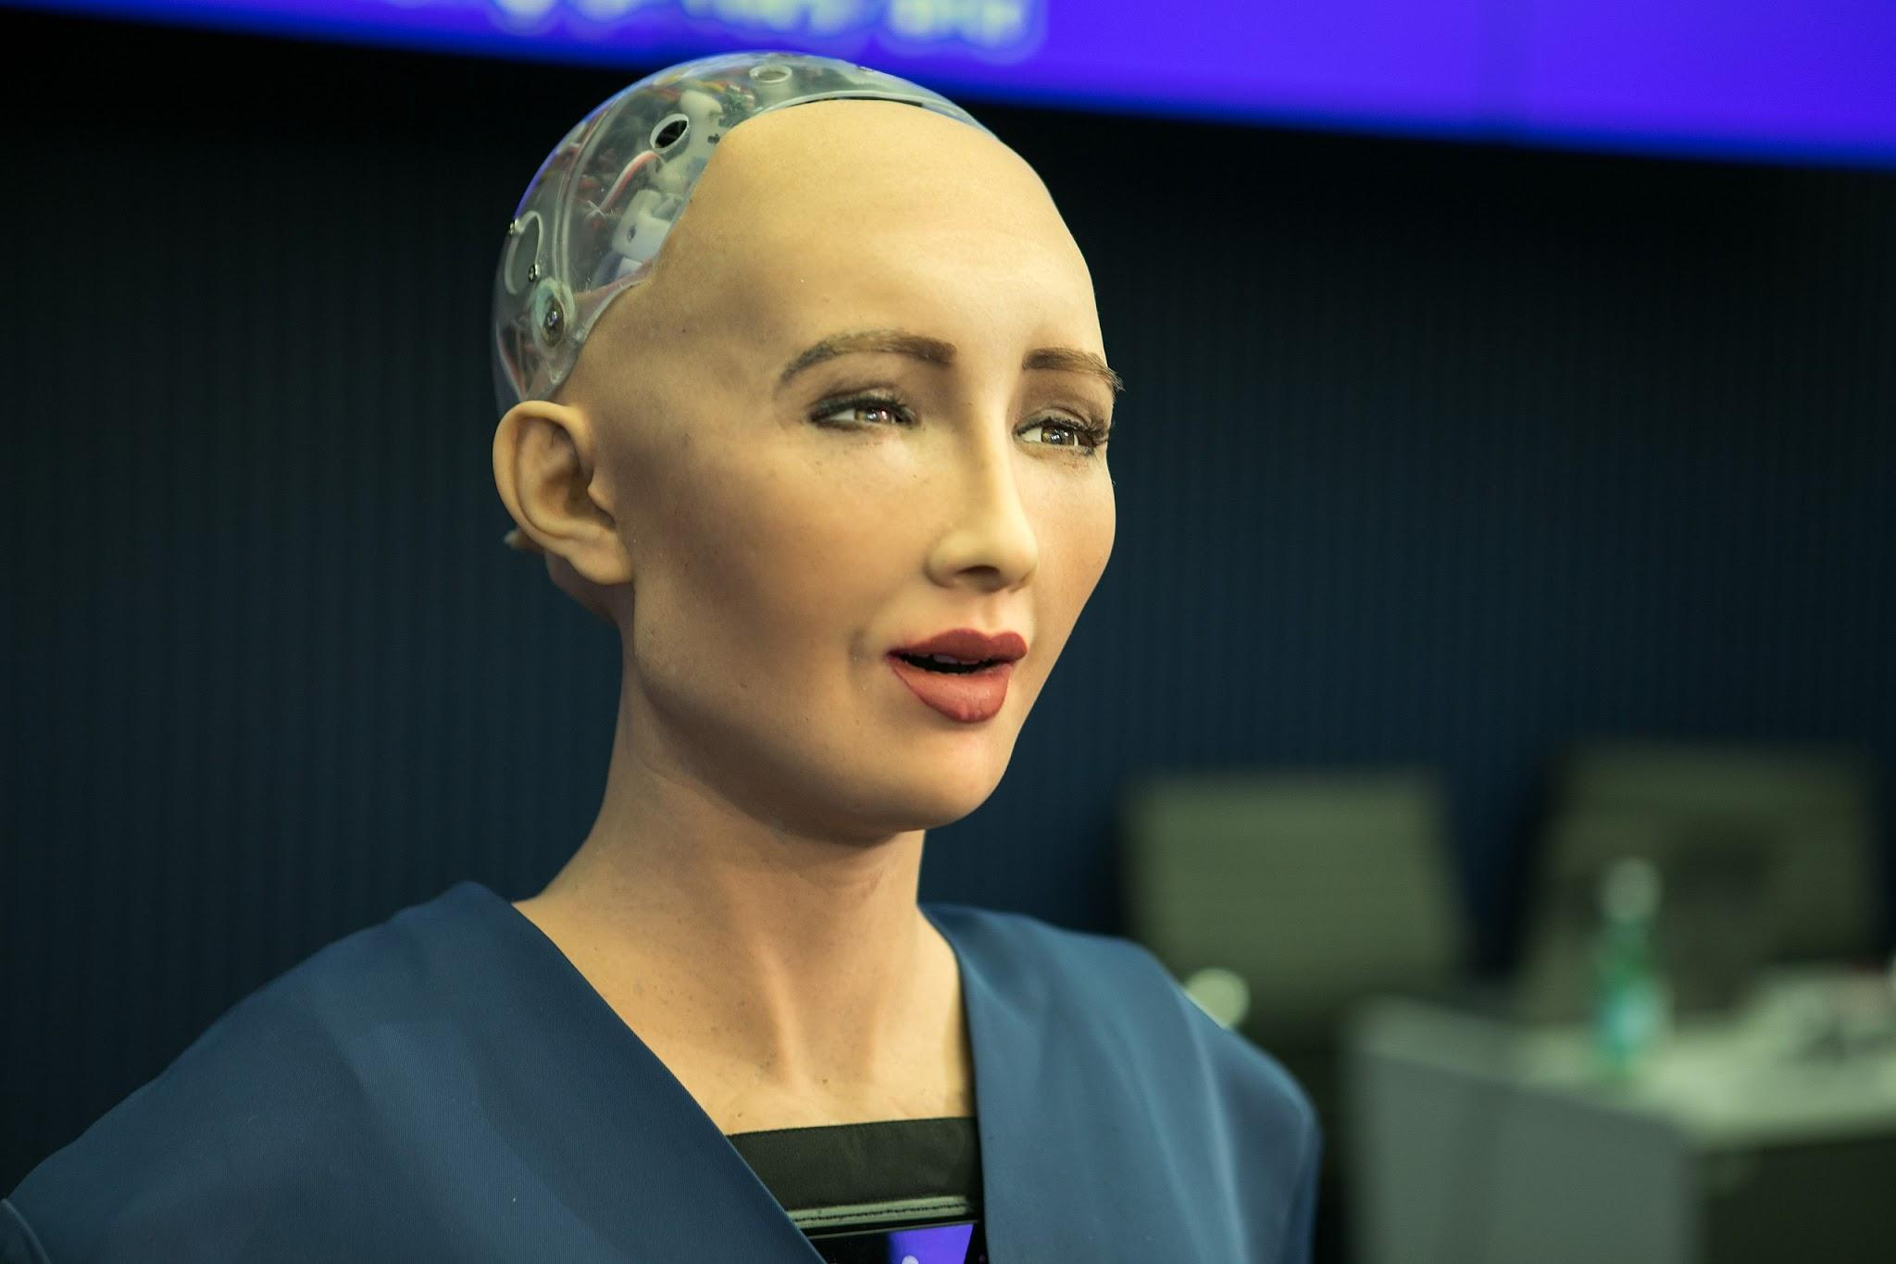
Sophia
Sophia, developed by Hanson Robotics, is known for her advanced AI and ability to interact with humans. She has even been granted citizenship in Saudi Arabia.
Sophia's features include facial recognition technology, natural language processing, and the ability to express emotions through her facial expressions. She has been featured in numerous media outlets and has even given speeches at events around the world.

Slide 6
Sophia Unveiled
Sophia, even though regarded as the most advanced humanoid robot is still only a piece of technology advertised brilliantly.
It has faced many critics across the world regarding its citizenship in UAE only as a publicity stunt and to attract AI markets toward UAE.
Its software is 70% copied from open-source communities and even its voice modulation is backed by CereProc inc.
All the conversations and interviews you find online are pretrained into Sophia some days before the recording and are mostly hard-coded by the developers.
Many researchers and scientists across the globe believe Sophia to be just a hardcoded chatbot with facial expressions.
Sophia’s Self portrait was sold at $700K - CNN
Various attestations are provided on the next slide.
Source- https://en.wikipedia.org/wiki/Sophia_(robot)

Slide 7
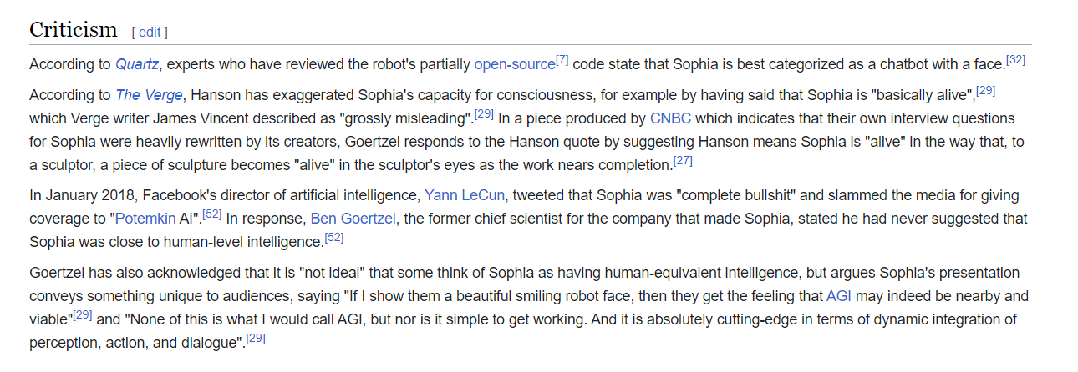
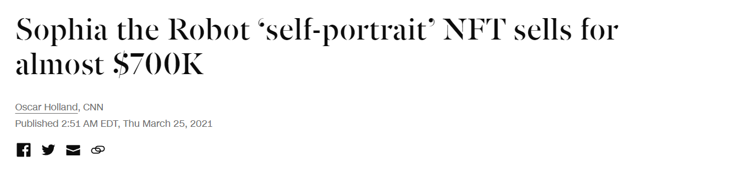
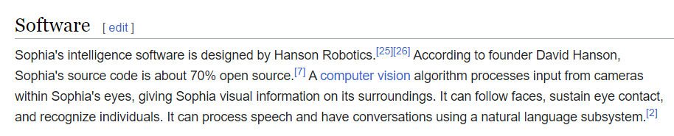

Slide 8
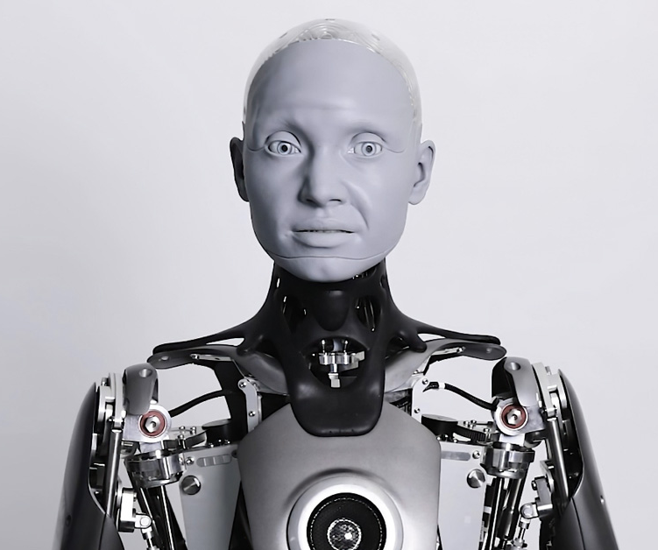
Ameca
The Ameca robot is developed by the Mexican government as a research project by the company Engineered Arts. She is designed to be a low-cost alternative to more expensive humanoid robots.
Ameca, while less well-known than Sophia, is still an impressive robot. She is designed to be modular, meaning that different parts can be easily swapped out and replaced. This makes her a great option for research projects and experimentation.

Slide 9
Ameca unveiled
Ameca appears to be a fairly recent creation as it was posted out in 2021 but it took 15 years to make it.
It was made by a funding provided by the Mexican government in secrecy to a UK-based company named Engineered Arts.
The walking mechanism of Ameca is still under construction and its creators are facing problems. As of now, Ameca only has the torso and is not able to move, even with a wheel mechanism.
It entirely depends on ChatGPT or human telepresence for its answers. Telepresence means a person is present near the robot, feeding the answers to the robot in real time and the robot only lipretes it.
The cost of a buying a single Ameca is over $133,000.

Slide 10
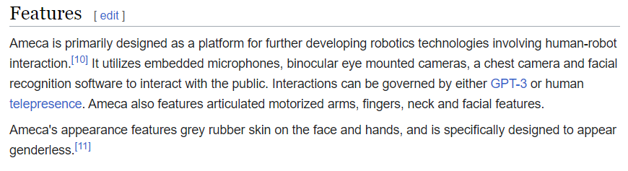
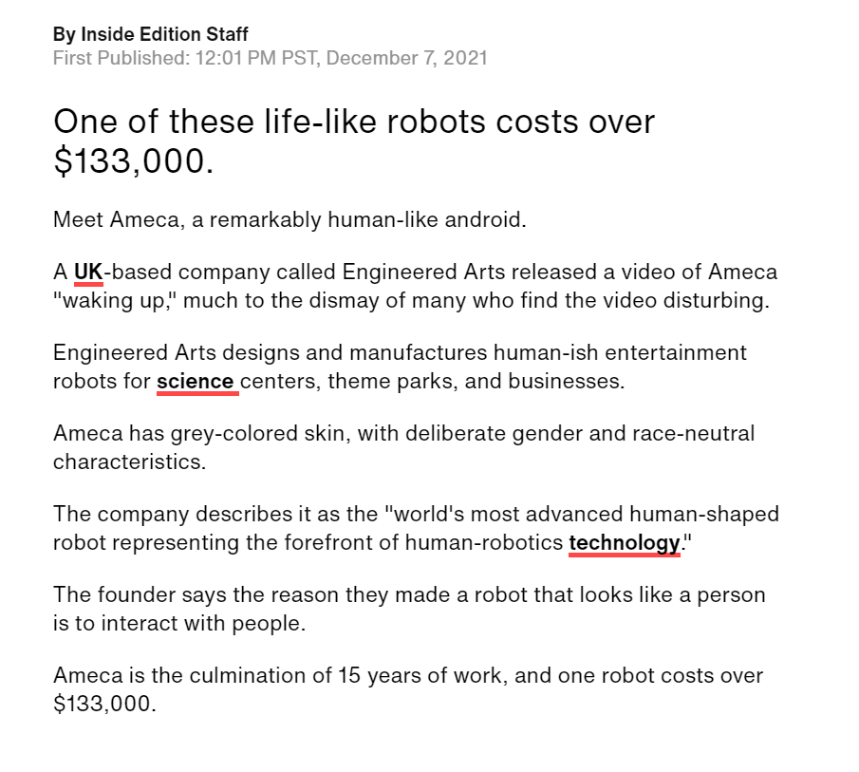
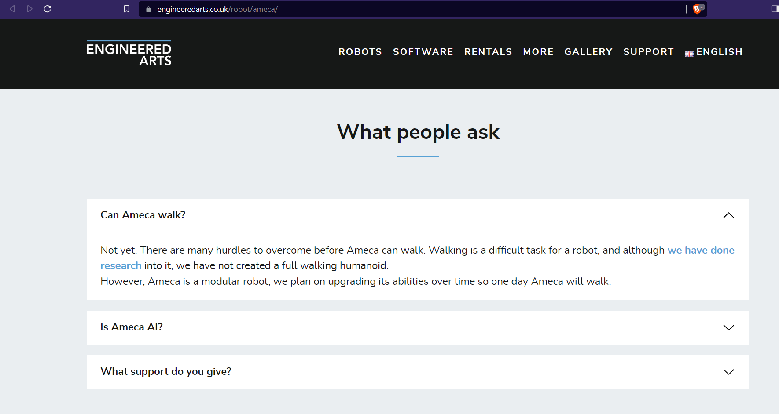

Slide 11
Robots in India
There are various instances where India has tried gloriously to compete with these “robot superstars”. Some of them were made for international competitions such as RoboCup, while some of them were made using domestic items for a fanciful display.
According to a report by MarketsAndMarkets inc., the humanoid robot market is expected to register a CAGR of 63.5% between 2022 and 2027. India has been ahead in the robotics race, making it to the top 15 list of the highest number of recorded robots installations in 2020.
Unfortunately, none of Indian robot is completely Humanoid with atleast proper human-like hand gestures.
Further, we shall see the All the humanoid robots made in India. (references attached)
https://analyticsindiamag.com/9-humanoid-robots-made-in-india/
https://aitechtrend.com/10-humanoid-robots-that-are-made-in-india/
https://roboticsindia.live/top-10-made-in-india-humanoid-robots-2022/
https://www.technoxian.com/techiela/top-humanoid-robots-made-in-india/

Slide 12
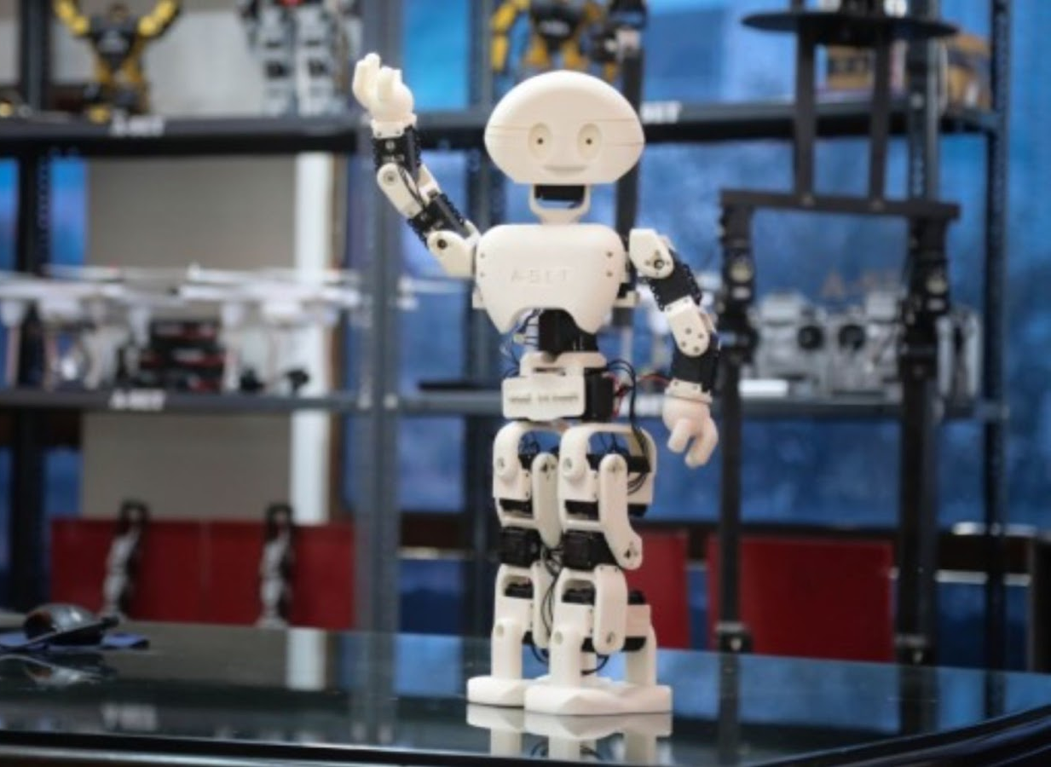
Manav
Manav, India’s first 3D printed humanoid robot, was first unveiled at IIT Bombay Tech Fest. About two feet tall, the robot is able to perform tasks such as walking, talking and dancing by listening to voice commands.
It was built with an open source code so that it can be trained in real-time to learn and respond, similar to a human child.

Slide 13
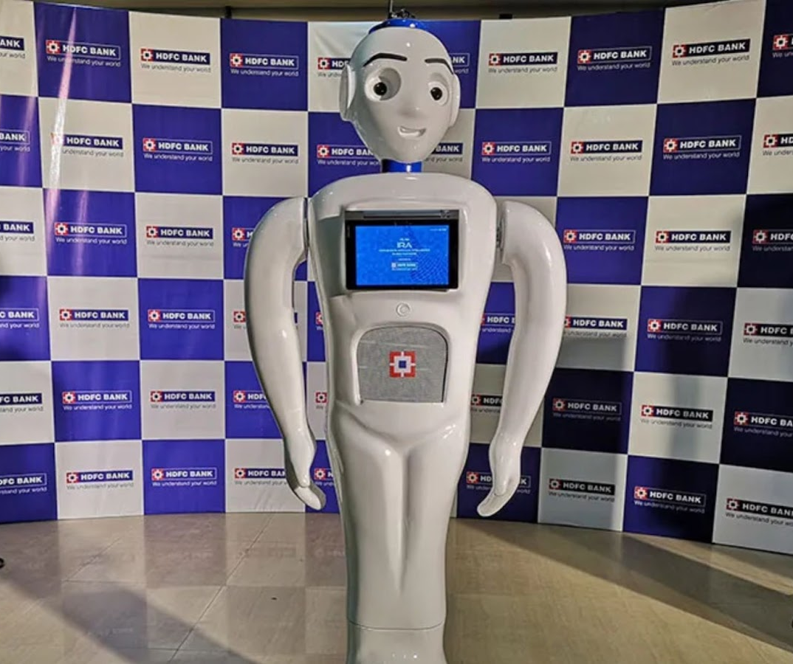
2. IRA
IRA, launched by HDFC Bank Ltd, was placed near the welcome desk at a branch in Mumbai. The first phase of the project involved the robot greeting customers entering the bank, and showing them a list of the services offered by the bank.
Customers could select an option and the robot would guide them to the relevant counters in the branch.

Slide 14
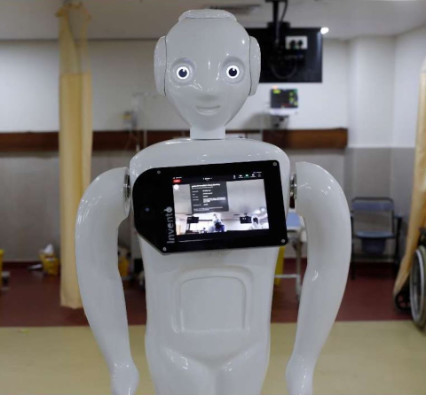
3. Mitra
Mitra, a customer-service robot, was developed by Bangalore-based Invento Robotics.
It is famously known for greeting Ivanka Trump and Prime Minister Narendra Modi at the GES 2017 summit, and declaring the event open.
The robot rose to prominence during the Covid-19 pandemic, where it was deployed in hospitals as a point of contact between patients and their loved ones. Patients could connect with them through a screen attached to its chest.

Slide 15
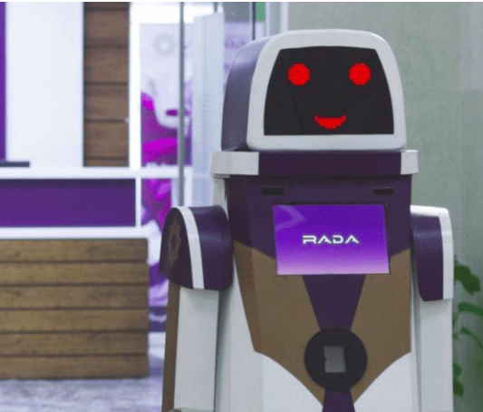
4. RADA
Built on a four-wheel chassis with 360-degrees rotation, RADA is a customer-assistance robot for Vistara Airlines, deployed at the Indira Gandhi International airport, Delhi.
The robot was designed to serve Vistara’s customers by responding to their queries, and providing several entertainment options like games, songs, and videos.

Slide 16
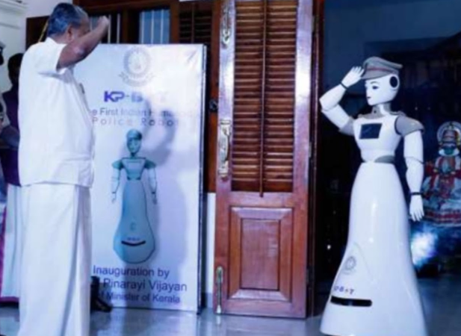
5. RoboCop
RoboCop is a Sub Inspector (SI)-ranked robot, stationed at the Kerala police headquarters, in Thiruvananthapuram. The robot was tasked with managing the front office at the headquarters.
The visitors could directly interact with the KP-robot, receive directions on where they need to head, as and when necessary. RoboCop was also able to perform certain additional features such as fixing meetings, issuing identity cards, or opening new files based on the concerns of the public.

Slide 17
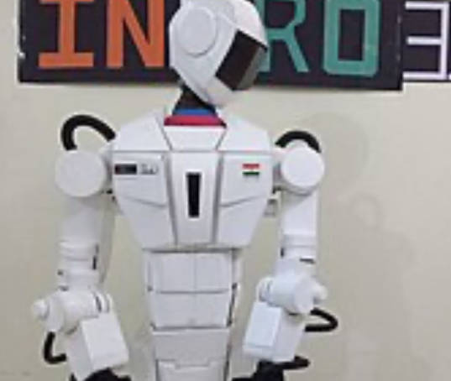
6. Indro
INDRO is the tallest humanoid robot made in India. Created by Santosh Hulawale, it was built with low-cost materials inside a house, and can be used for household chores, entertainment and education-related activities.
The robot can carry up to 150 kg of payload on the platform placed below its knees. It is also capable of lifting up to 2 kilos of weight with its hands and has the ability to perform all ‘human-like’ actions. INDRO is open source, allowing its users to program the bot according to their requirements.

Slide 18
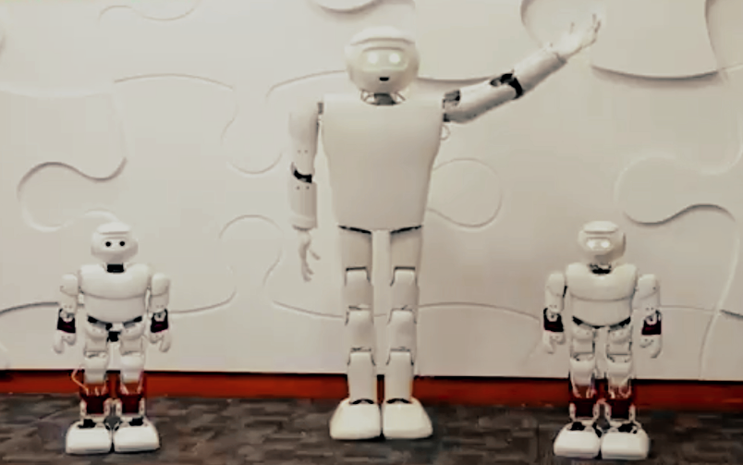
7. Kempa
KEMPA, also a customer-assistance robot, was built by Bangalore-based Sirena Technologies. The bot, which was deployed at the Kempegowda International Airport, would help passengers with their flight-related queries, like providing information about flights, check-in details, scanning luggage, and handing out boarding passes.

Slide 19
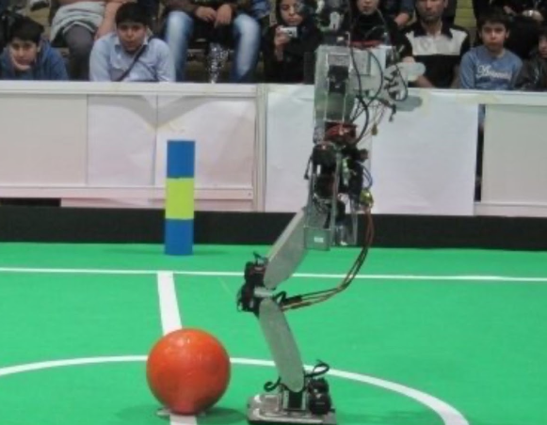
8. AcYut
AcYut, known to be India’s first indigenous robot, was developed by undergraduate students at the Birla Institute of Technology and Science (BITS), Pilani, India. The project had quite a few sponsors, most notably Govt. of India (DEITY) and BITSAA.
At numerous international venues, such as RoboCup, RoboGames, CMU, Stanford, etc., AcYut has represented India. AcYut is also consistently the sole team representing India in the highly technological Humanoid Teen Sized Soccer Leagues at Robocup, where robots compete in autonomous soccer matches.

Slide 20
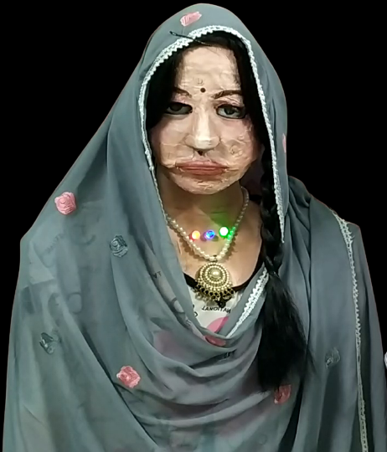
9. Shalu Robot
Robot Shalu is a homemade, artificially intelligent, multilingual, social and educational humanoid robot, made-up of waste materials, that can speak 47 languages (9 Indian and 38 foreign), developed by Dinesh Kunwar Patel, a Kendriya Vidyalaya, Computer Science teacher from Mumbai, India (native of Jaunpur, Uttar Pradesh).
Shalu is recognized in the top ten humanoid robots of the world by Danik Bhaskar, Vaartha, TIME magazine, and Hindustan News. Shalu is also among top 5 trending Indian robots in the global Tech Market.

Slide 21
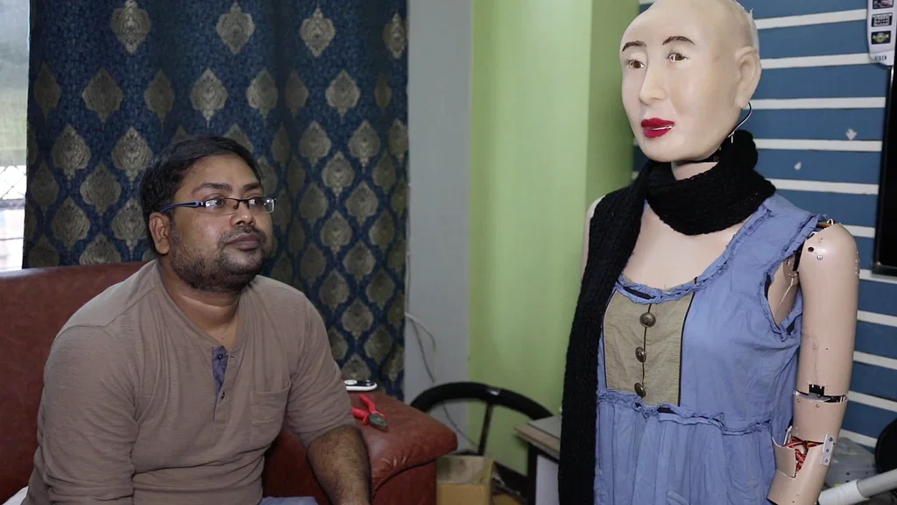
10. Rashmi Robot
Rashmi is an Indian lip-syncing humanoid robot developed by Ranjit Shrivastava, a programmer from Ranchi, India.
This robot was launched on 1 August 2018, 2 years after the start of its development. This robot appeared in India's Got Talent season 8.
Rashmi appeared on Red FM from December 3, 2018. The robot hosted an “Ask Rashmi” segment where it replied to listener's queries on radio. Robot Rashmi also hosted a show with RJ Raunac aka Baua.
Two ISRO scientists, met Shrivastava to determine if the existing robot could be upgraded with certain simulated features resembling human physiology ISRO later developed their own Vyommitra robot for this purpose.

Slide 22
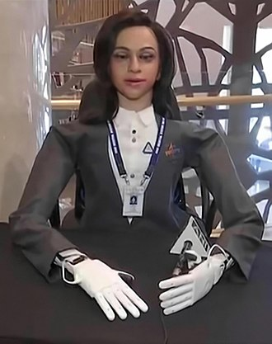
11. ISRO Vyommitra Robot
Vyommitra (from Sanskrit: vyoma, "space" and mitra, "friend") is a female-looking spacefaring humanoid robot being developed by the Indian Space Research Organisation to function on-board the Gaganyaan, a crewed orbital spacecraft. Vyommitra was first unveiled on 22 January 2020 at the Human Spaceflight and Exploration symposium in Bengaluru.
It will accompany Indian astronauts in space missions and will also be a part of uncrewed experimental Gaganyaan missions prior to the crewed spaceflight missions.
It will fly humanoid robots for a better understanding of what weightlessness and radiation do to the human body during long durations in space.

Slide 23
KIET’s Own Humanoid Robot that stands at the potential to represent India on International Level.

Slide 24
Features of Anushka
Speech
Anushka has a huge support for most of the languages in the world and can understand their foreign accents. She has been thoroughly tested with Hindi, English, Urdu and Punjabi as of december 2022.
Advanced chatting system based on complete ripoff of human mind and psychology, adapted from vedic scriptures, specially built with neutralism and non-discrimination.
During speech reply, it runs a parallel process for determining the emotional tone of conversation and add gestural sound effect. ex- chuckle.
Equipped with information to be used as a Humanoid Receptionist for KIET Group of Institutions.

Slide 25
Features of Anushka
Speech
Weather prediction system with worldwide realtime support.
Integration of various sound effects such as whistling, chuckling to enact human emotions.
Real-time posting of conversation to the remote server with time stamp to monitor conversation.
Smart voice rate increment or decrement according to the tone of reply to show excitement or sympathy.
The robot comes with 3 mics attached and the Hearing module can smartly prioritize mics index to be used as primary mic in case of noise and disruption. In such case, it may use that mic as a ground reference or to set noise reduction threshold.

Slide 26
Features of Anushka
BOSS
A dedicated operating system called BOSS with special emphasis on Modular design of components.
Master Program that keeps a check over all modules working fine and communicating with each other seamlessly. Can intelligently decide whom to give exclusive access to file systems in case of potential deadlock between two or more files.
Intelligent Forced-Priority based Multithreading.
Smart communication between hearing and vision module to access rights for speech module whenever and however necessary.

Slide 27
Features of Anushka
BOSS
Proper port checking and smart forced-assignment of ports to different modules of the robot in case of loss of communication port.
Brain module is designed to smartly segregate by evaluating if an information should be stored for long term or short term only.
Special Admin Mode to command the robot with special authority such as turning it off or follow me mode operation.

Slide 28
Features of Anushka
Monitoring Systems
Extremely secure monitoring systems with zero tolerance for privacy breach or chances of malicious order sent to the robot from the remote server.
Remote monitoring system with unidirectional data flow for extra security and enforced privacy.
Logs and Errors passed to remote server only when monitoring systems get an initial acknowledgement. In case of no acknowledgement, monitoring systems can ask BOSS to take vital decisions for the local system.

Slide 29
Features of Anushka
Monitoring Systems
Monitoring system can smartly decide which modules closed gracefully or forcefully or were suddenly shut down due to error(s)
Special birthday mails generated by the remote server in real time to wish various faculties and students of the college.
Support for printing of various mails and applications in real time by the remote server as per demand put forward to the robot.

Slide 30
Features of Anushka
Vision
Advanced face recognition and tracking and automated response mechanism.
Advanced following with pose estimation and ‘single lens distance approximation’ technique.
Realtime remembering of people by clicking their photo and updating the database in parallel thread while recognizing people in primary thread.
Smart mapping of neck movements according to the number of people present in the robot's view.
Support for remembering strangers’ faces anonymously. The vision module is defaulty in recognition mode which continuously maintains a set of faces that the robot has witnessed in last 2 hours. It does so by parallelly generating face encodings for the recurrent faces. In case of a person returning soon, the robot shall not wish them again and again.

Slide 31
Features of Anushka
Vision
The robot can not only recognise the faces in its database but also keeps track of the unknown faces for over two hours. The use of a novel face recognition technology incorporating YOLO with smart cropping of the photo to maximize facial area provides excessive speed of recognition to the robot.
Asking for a cleaner image in case the robot tries to capture the image of a person to remember him/her but the image comes out blurry for more than 5 times. The robot can smartly deduce if the person has changed within this period of capturing photo, which it conditionally rejects.

Slide 32
Features of Anushka
Gestures
More than twenty hand gestures with ten extra palm gestures helping the robot to bring forth her reply with assisting body language including Hi, shaking hands, salute, horns, preach, cheese, okay etc.
Eye gestures are produced to show that the robot is "thinking" by optly applying body language science.
Smart jaw synchronization with the speech by determining the length of speech and then oscillating the jaw accordingly.
Neck movements to deliver speech to multiple number of people present together.
Smart neck movement based on a new person entering the scene.

Slide 33
Features of Anushka
Structure
Completely devoid of hydraulics, employing servo motors for smooth operation.
Symmetric gesture angle for each hand for distributed load over the body.
Separately dedicated power supply to each hand for proper gesture outcome.
Each embedded system has special keywordID of communication (SKC) for easy troubleshooting and module recognition during maintenance.

Slide 34
Still, What Makes Anushka the Most Promising of them All ?

Slide 35
Our Unique Selling Proposition
The only robot worldwide whose Heart beats. The initial and final beats of heart are louder while the beating of heart slows down in normal setting. The heartbeat rises as the pressure increase on the system due to power loss or increased resource usage.
FollowMe mode for Rolls module that smartly maps the distance between the person and the robot using only the 2D camera and no depth sensor. It uses the novel approach of single camera distance measurement by employing ‘len's makers formula’ to measure this distance by the focal length of the camera used in robot. It smartly deduces the number of seconds the motors of the wheel mechanism have to move to rotate or move forward towards the person based on feedback of robot's wheels' angular velocity.
Support for understanding Indian Sign Language.
Made within a period of only 8 months.
Completely modular software.
Made within a cost of 1 Lakh INR only.

Slide 36
Our Unique Selling Proposition
The core smartness of Anushka lies in the fact that it uses layers of psychological approach to generate replies. Her brain has been designed according to the vedic concept of mind in hindu scriptures that state that human mind is made of 4 parts: Chitta (conscience), Manas (memory) , Ahankaram (personality) and Buddhi (intelligence). All these four parts have been programmatically coded into making of the brain module of Anushka.
Her chitta is designed through the use of deep learning and neural networks and mathematical approach.
Her manas consists of all the memory and information that she has about herself and her creators and where she is. Her memory has been divided into a huge bank of knowledge about herself and KIET known as 'knowledgeLog'. She is also connected to the internet to search for information she doesn't have currently in database. She then can smartly decide whether to store the surfed information for long time or for once only.
Her ahankara or personality is hugely shaped by the supervised pre-training that she has been given using the 'trainModel.py' file. It helps her to mold the facts that she have and present them in her 'tone' or mannerism.
Her buddhi (intelligence) comes from the procedure of combining all of the data together but still replying with the data that is closest to the context of user's query. For this, anushka has to keep track of the last queries and produce result according to user's context.

Slide 37
And how does it work?

Slide 38
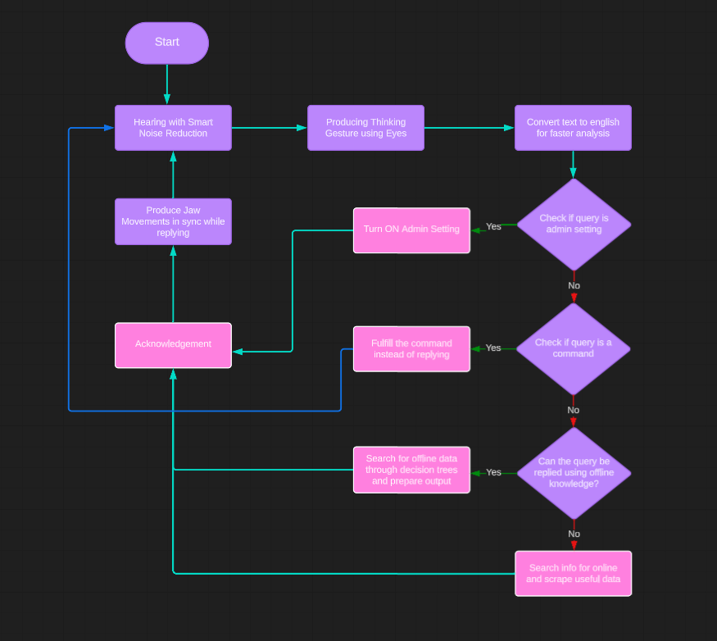
Anushka follows a methodical approach for replying which consists of analysing the query through a series of given schema:

Slide 39
Pre-Publicizing Reviews for Anushka

Slide 40
We, the Team31 got a chance to present our robot’s prototype sample at IIT Bombay and the results were promising and propitious.
Not only technically, Anushka stands a chance to win the hearts of people, local and beyond, due to its wide language support and interactive conversation inclusive of gestures.
Following are the various moments we could capture where people met her and engaged in conversation and found her helping and charming…

Slide 41
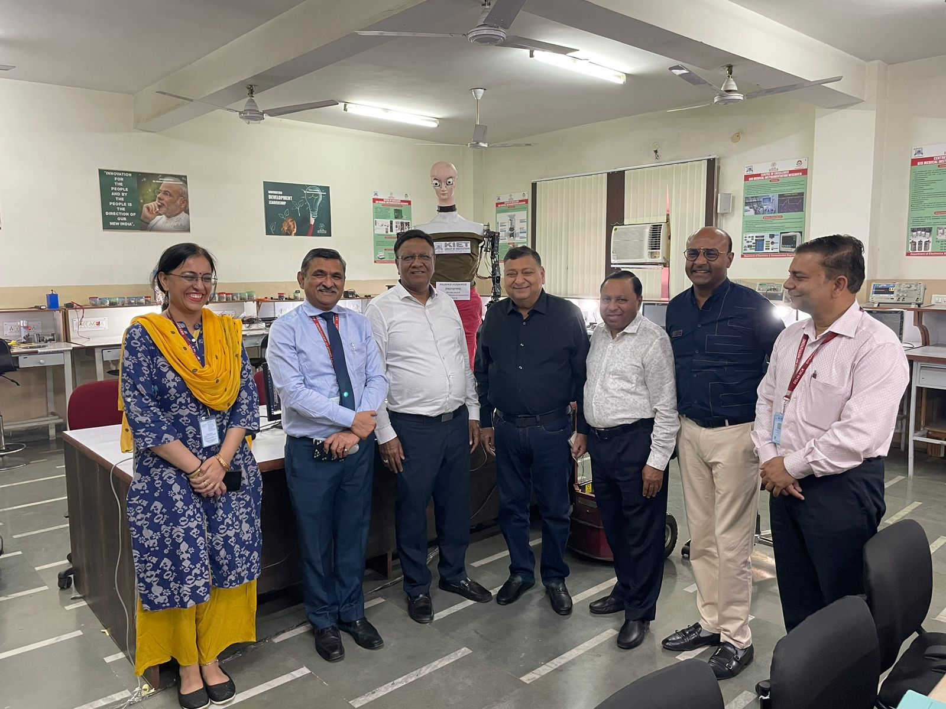

Slide 42
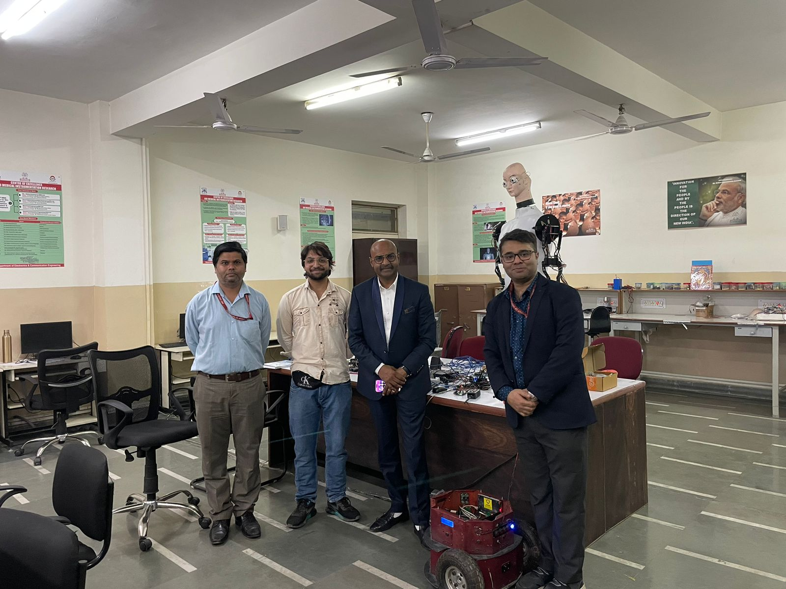

Slide 43
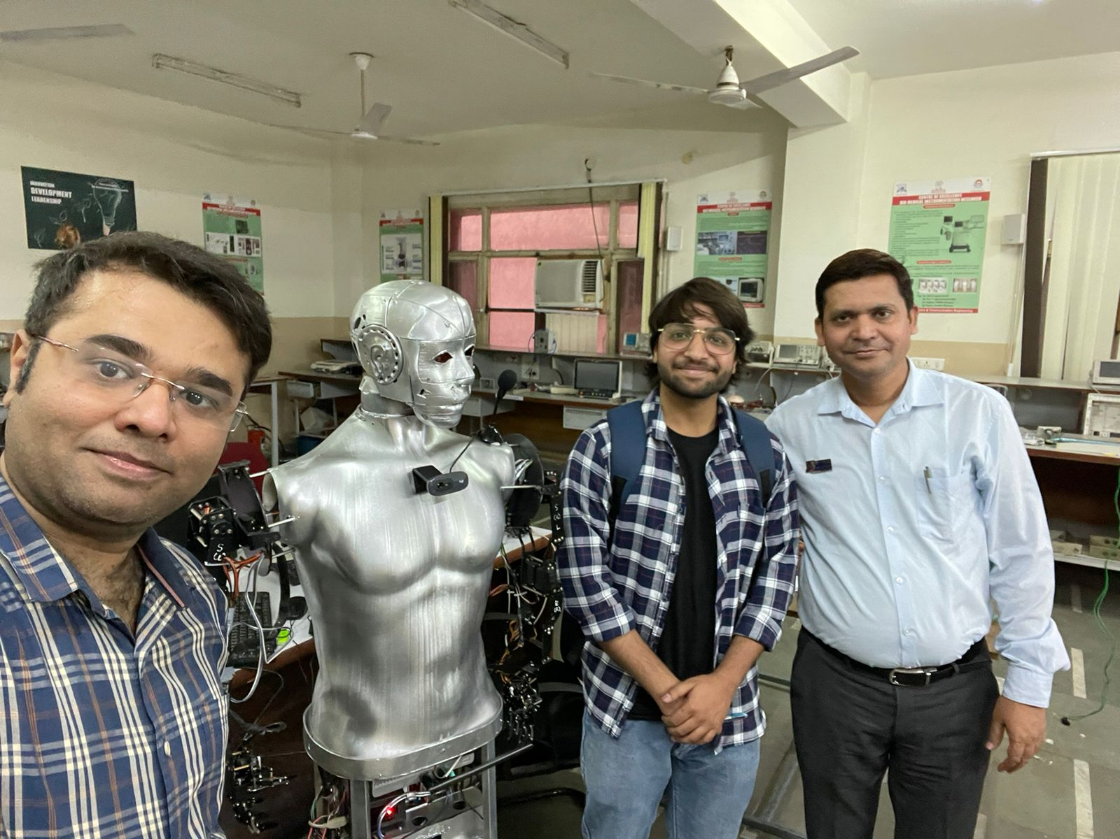

Slide 44
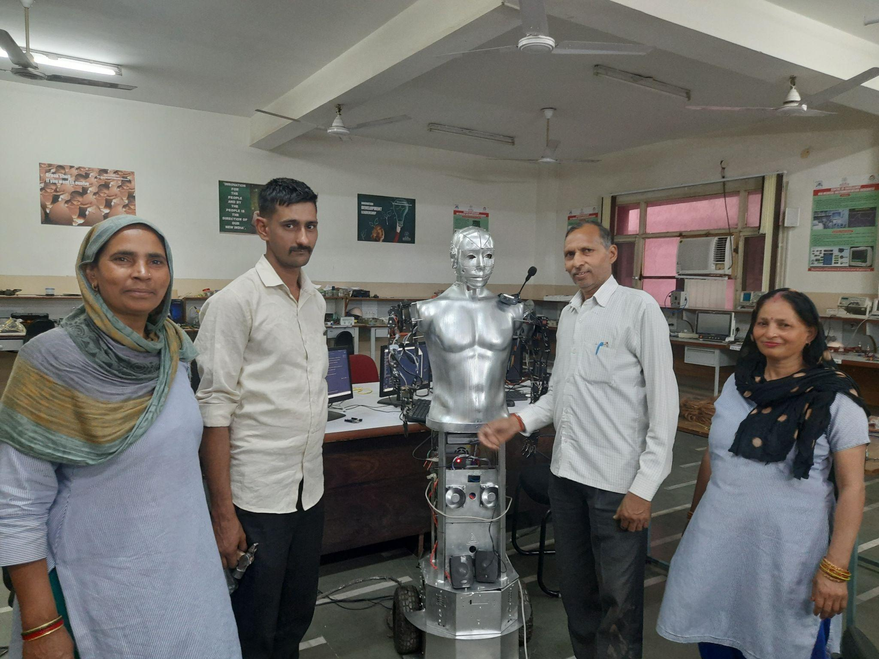
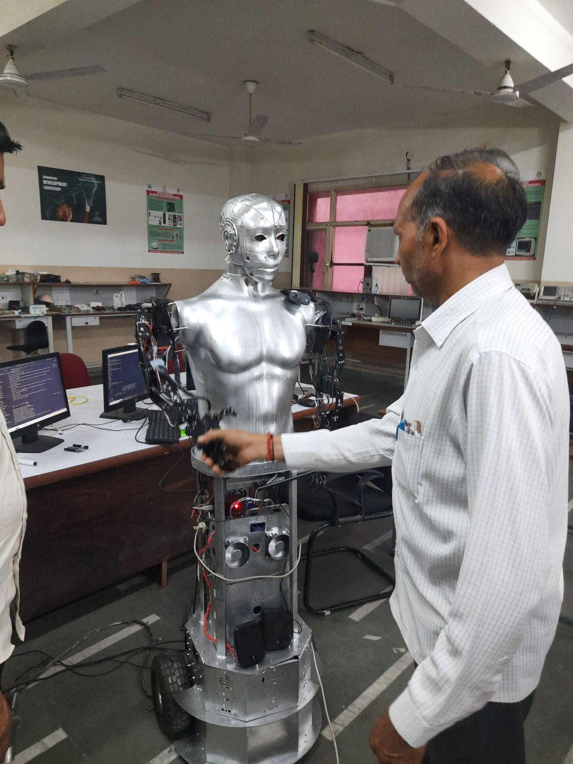
Do you know? The helping staff of ECE deptt already gave Anushka a name before her naming ceremony. They call her ‘Laado’, which means ‘Dear One’ .

Slide 45
Thankyou…

